Slide 1

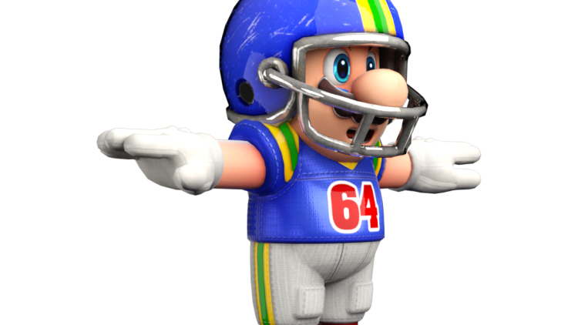

Football I
Produced by Dr. Mario | UNC STOR 390

Slide 2
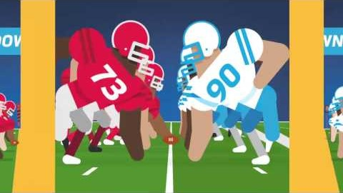
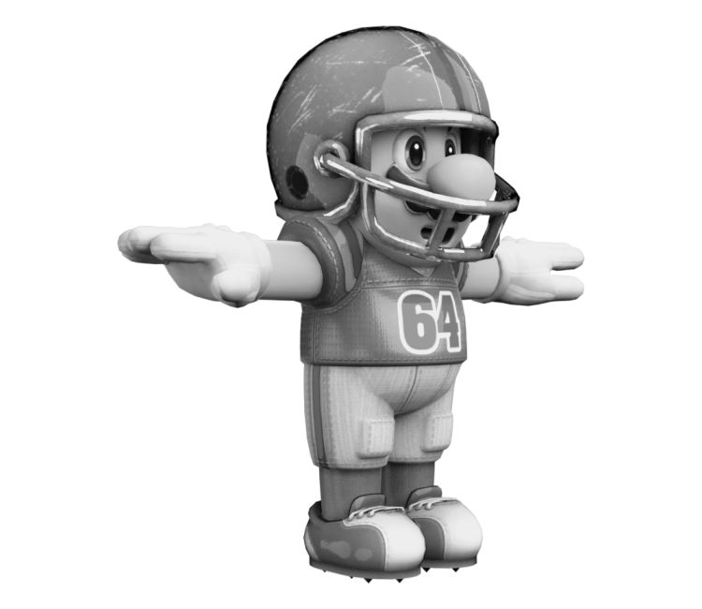
Overview of Football

Slide 3
What Makes Teams Win
Two Ways Offense Gains Yards
Passing
Rushing
Analysis by Bud Goode
Statistician from the 1960s
YDS = Yards
ATT = Attempts

Slide 4

Final Inspiration
If you don’t remember if you played football, you probably played football.
- Mahatma Mario

